Slide 1
Manipulating and Traversing HTML DOM Using jQuery

Slide 2
Objectives
In this session, you will learn to:
  Manipulate HTML elements

Slide 3
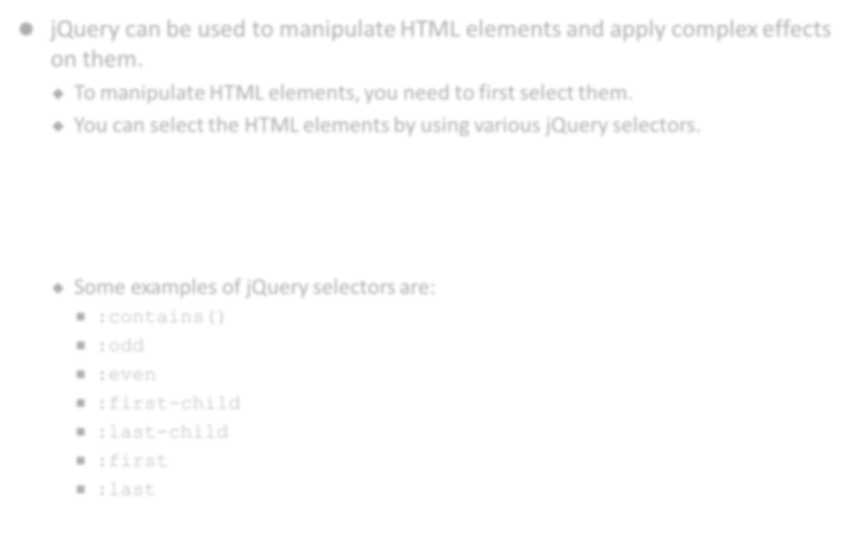

Manipulating HTML Elements
jQuery can be used to manipulate HTML elements and apply complex effects on them.
  To manipulate HTML elements, you need to first select them.
  You can select the HTML elements by using various jQuery selectors.
  Some examples of jQuery selectors are:
    :contains()
    :odd
    :even
    :first-child
    :last-child
    :first
    :last

Slide 4
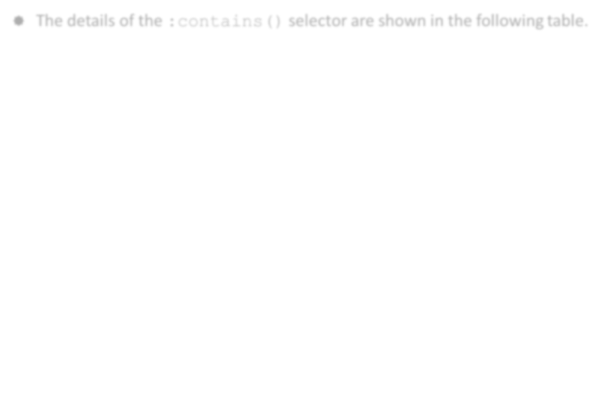
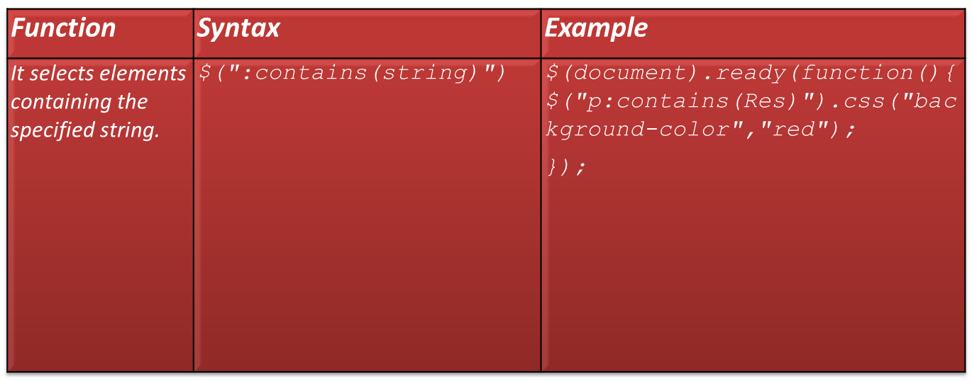
Manipulating HTML Elements (Contd.)
The details of the :contains() selector are shown in the following table.

Slide 5
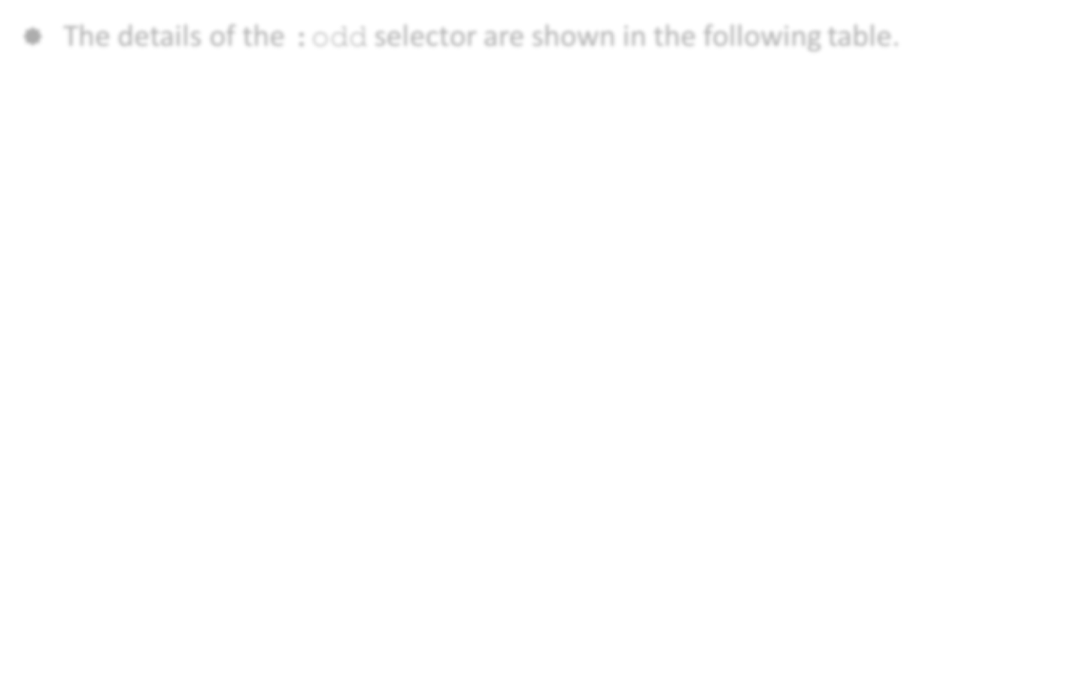
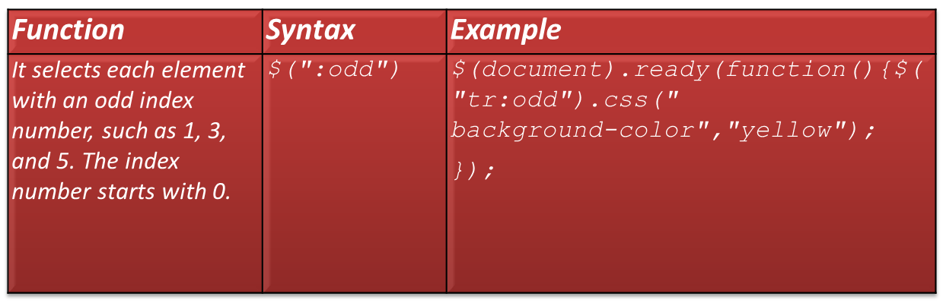
Manipulating HTML Elements (Contd.)
The details of the :odd selector are shown in the following table.

Slide 6
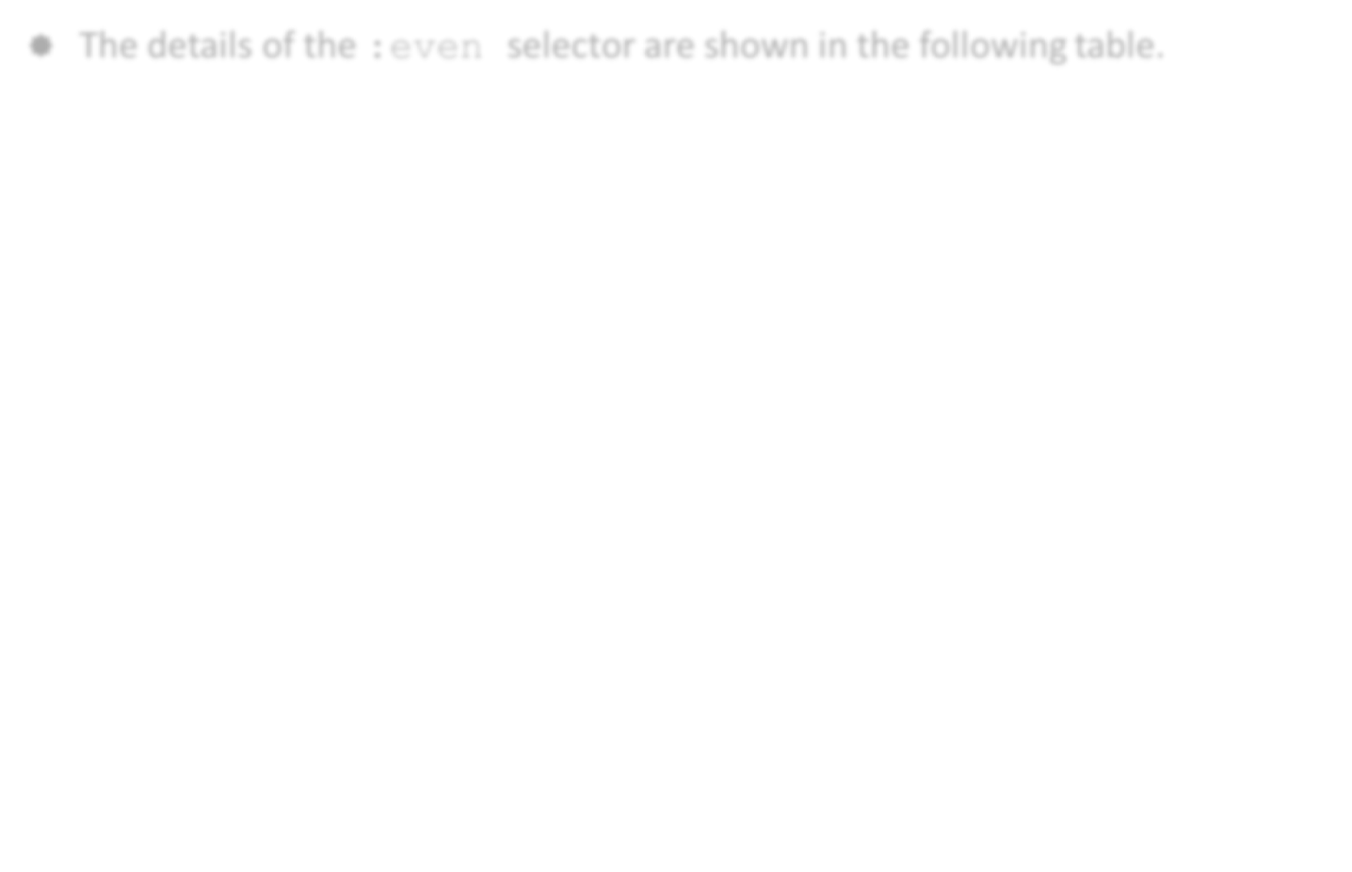
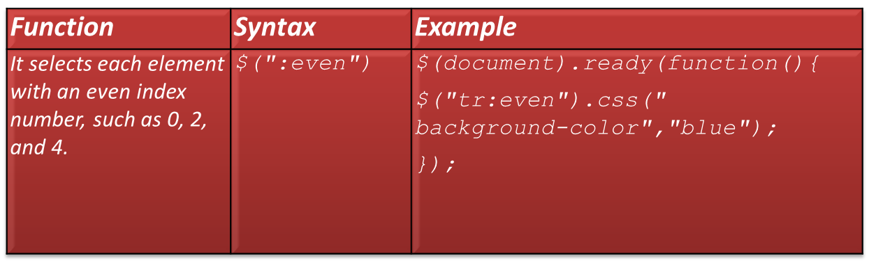
Manipulating HTML Elements (Contd.)
The details of the :even selector are shown in the following table.

Slide 7
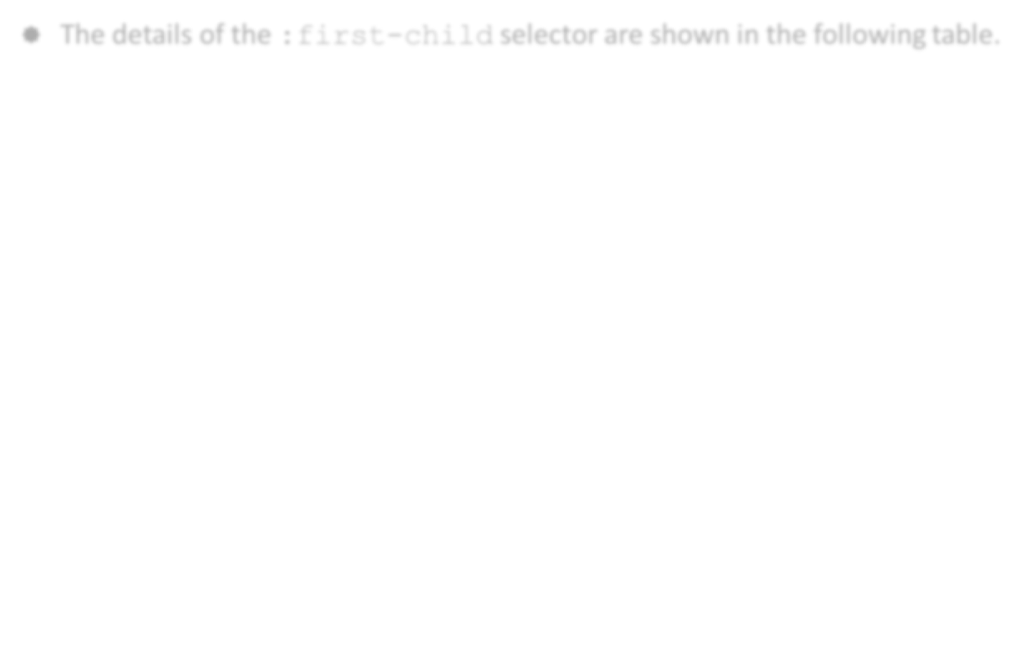
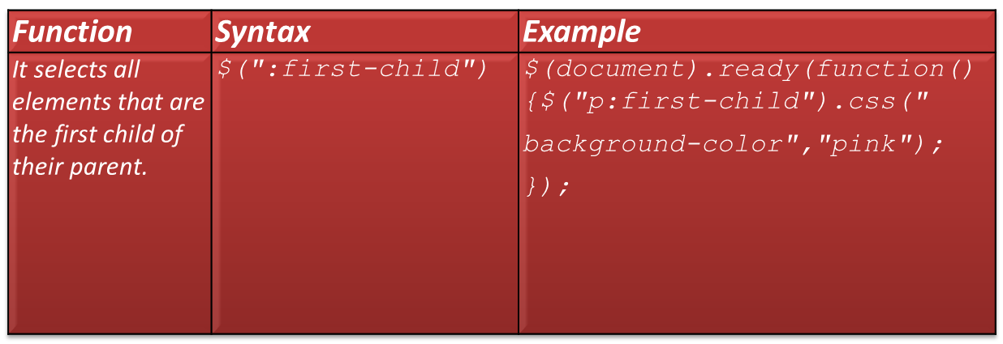
Manipulating HTML Elements (Contd.)
The details of the :first-child selector are shown in the following table.

Slide 8
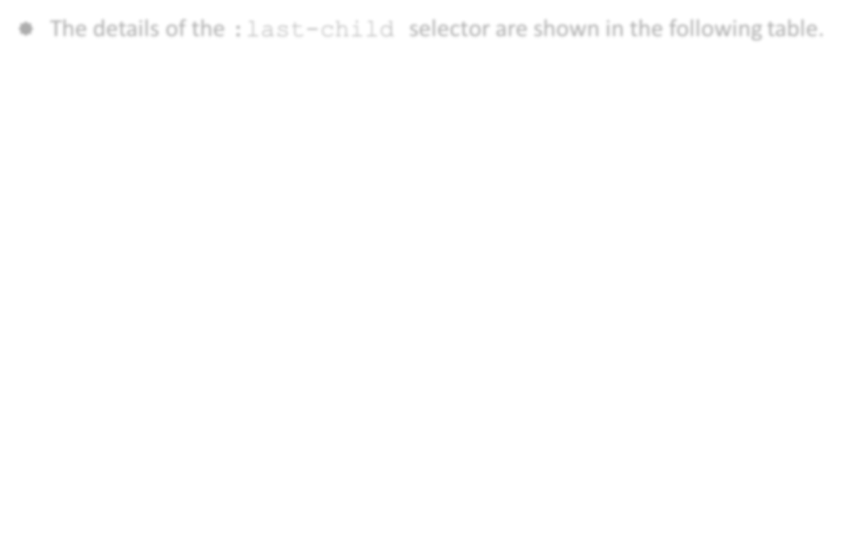
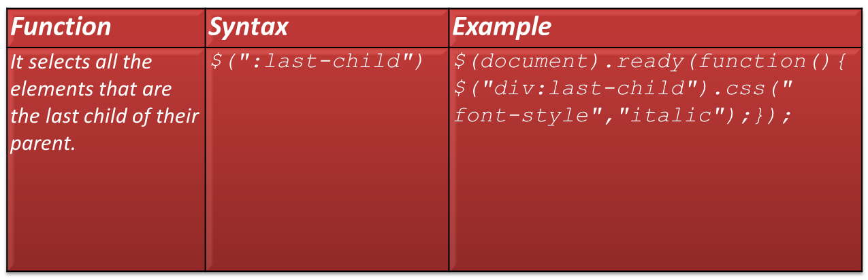
Manipulating HTML Elements (Contd.)
The details of the :last-child selector are shown in the following table.

Slide 9
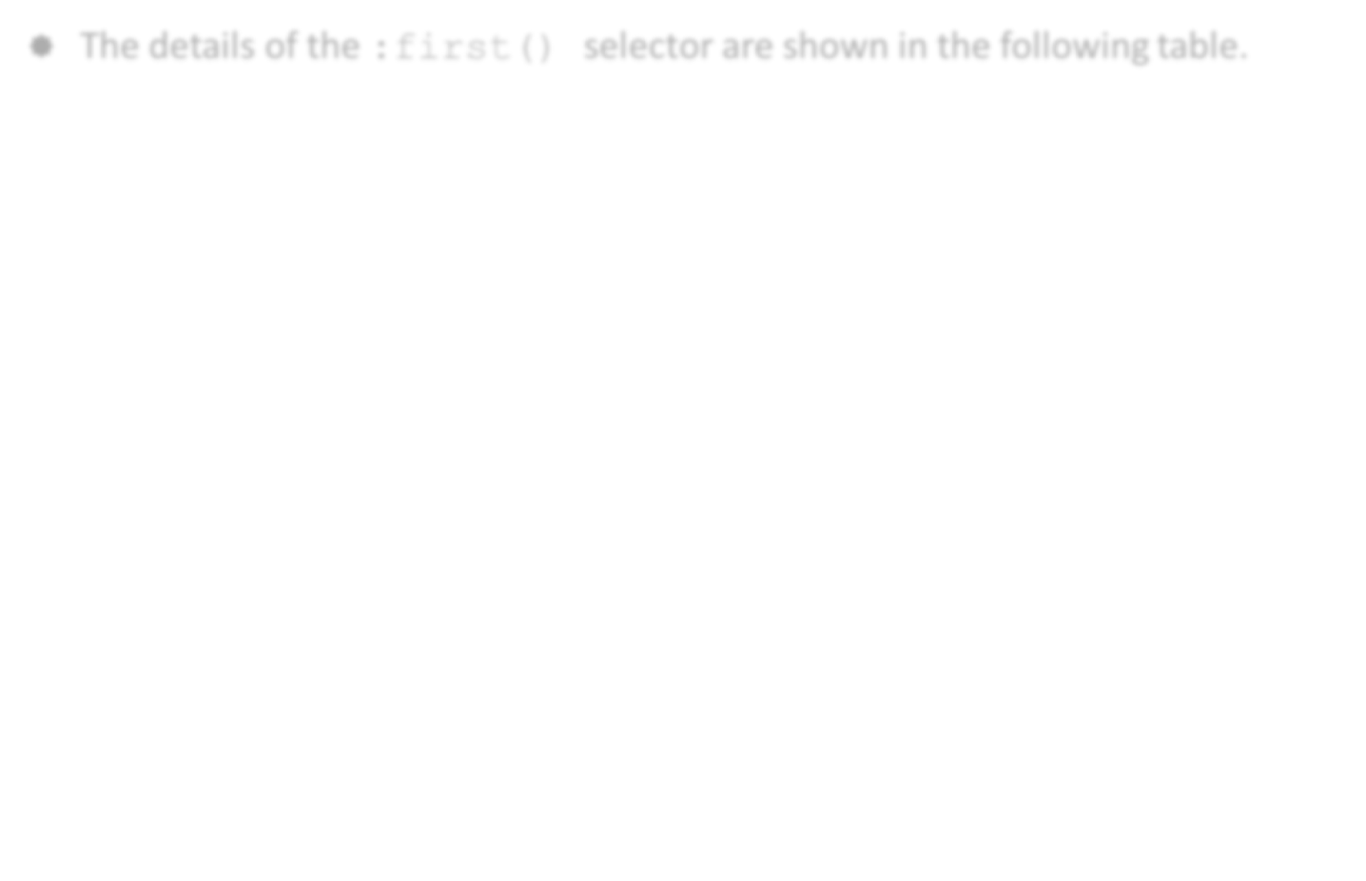
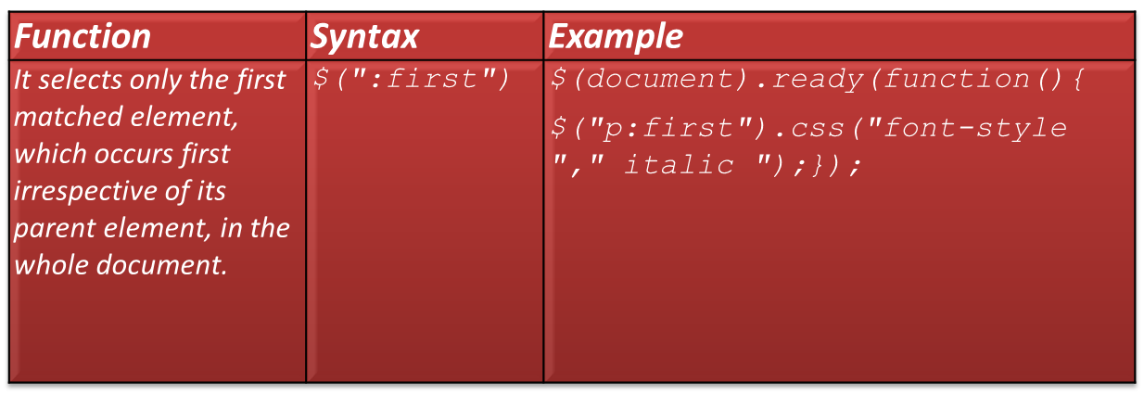
Manipulating HTML Elements (Contd.)
The details of the :first() selector are shown in the following table.

Slide 10
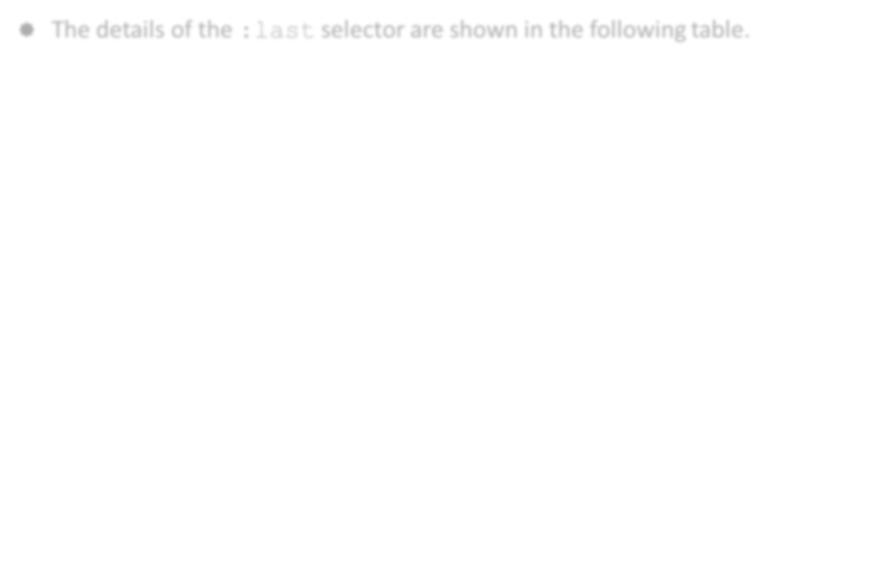
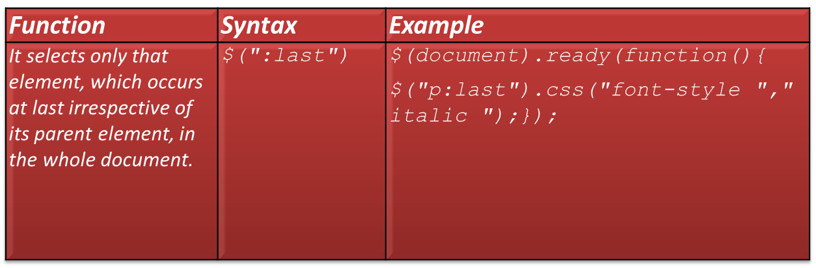
Manipulating HTML Elements (Contd.)
The details of the :last selector are shown in the following table.
Use the animation, RWD_06_jQuery_Selectors, to understand the concept of jQuery selectors.

Slide 11
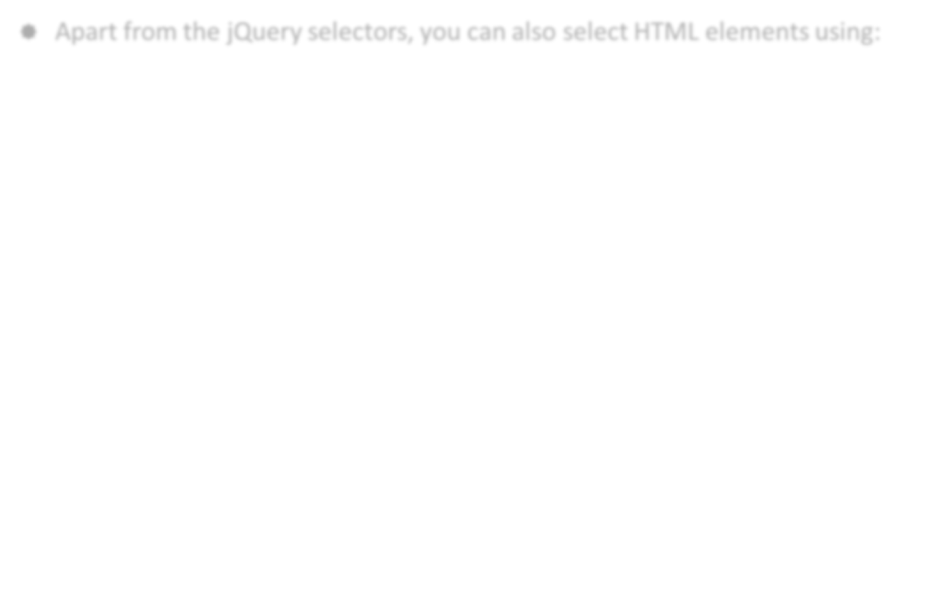


Manipulating HTML Elements (Contd.)
Apart from the jQuery selectors, you can also select HTML elements using:

Slide 12
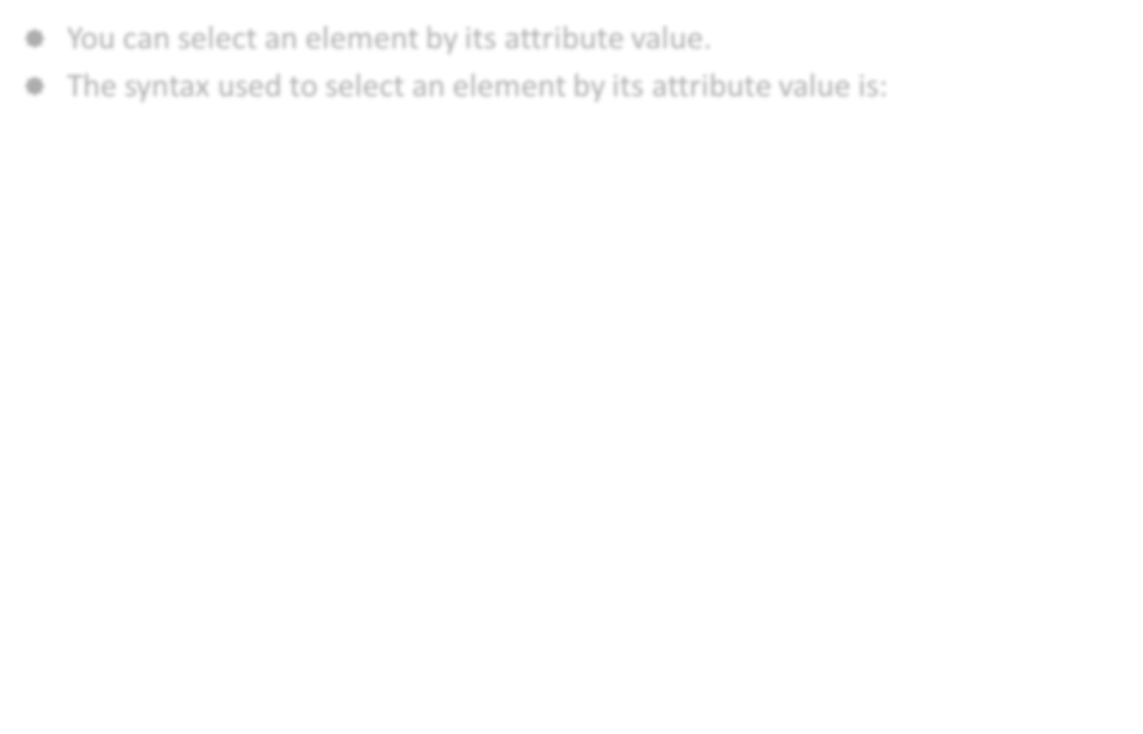
Using Attribute Values
You can select an element by its attribute value.
The syntax used to select an element by its attribute value is:

Slide 13
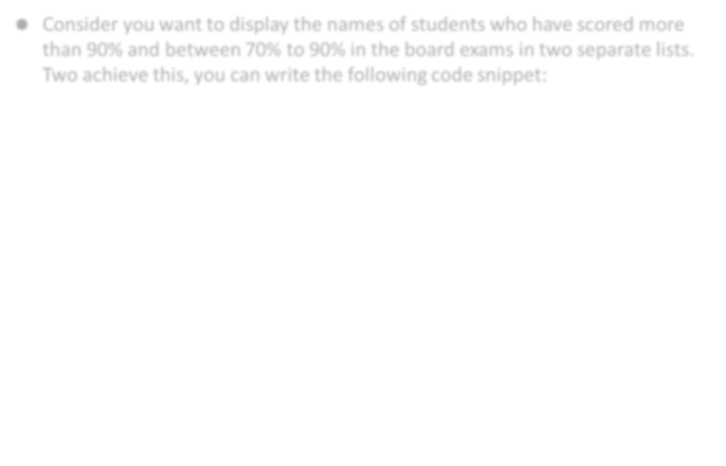
Using Attribute Values (Contd.)
Consider you want to display the names of students who have scored more than 90% and between 70% to 90% in the board exams in two separate lists. Two achieve this, you can write the following code snippet:
<div>Names of Students who have scored more than 90%:</div>
<ul class="Greater_Ninety">
<li>Stephen: 98</li>
<li>Joseph: 95</li>
<li>Mary: 92</li>
</ul>
<div>Names of students who have scored between 70% and 90%:</div>
<ul class="Lesser_Ninety">
<li>John: 85</li>
<li>Fred: 80</li>
<li>Steve: 78</li>
<li>Peter: 75</li>
<li>Barbara: 70</li>
</ul>

Slide 14
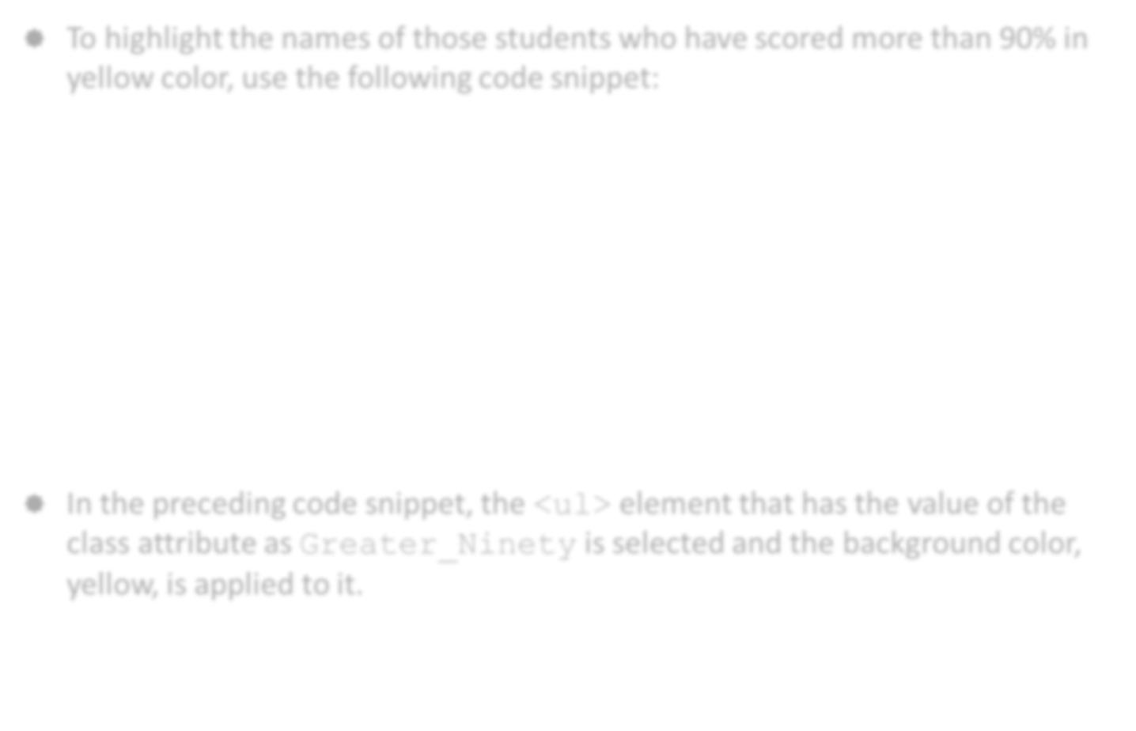
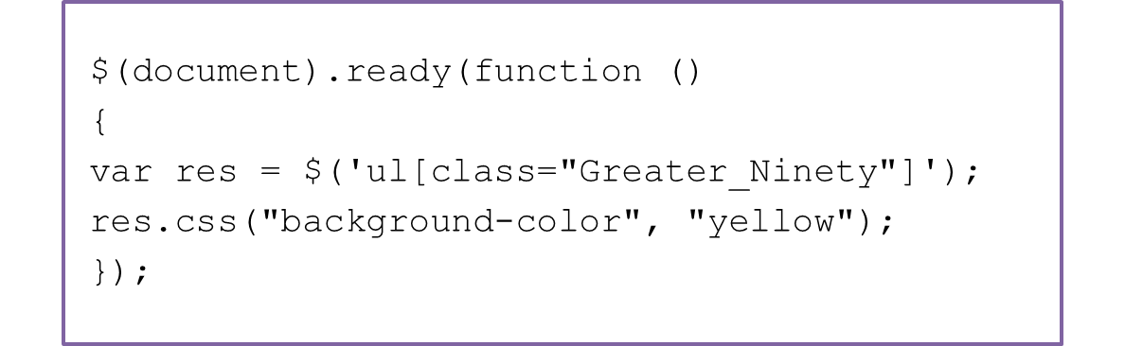
Using Attribute Values (Contd.)
To highlight the names of those students who have scored more than 90% in yellow color, use the following code snippet:
In the preceding code snippet, the <ul> element that has the value of the class attribute as Greater_Ninety is selected and the background color, yellow, is applied to it.

Slide 15
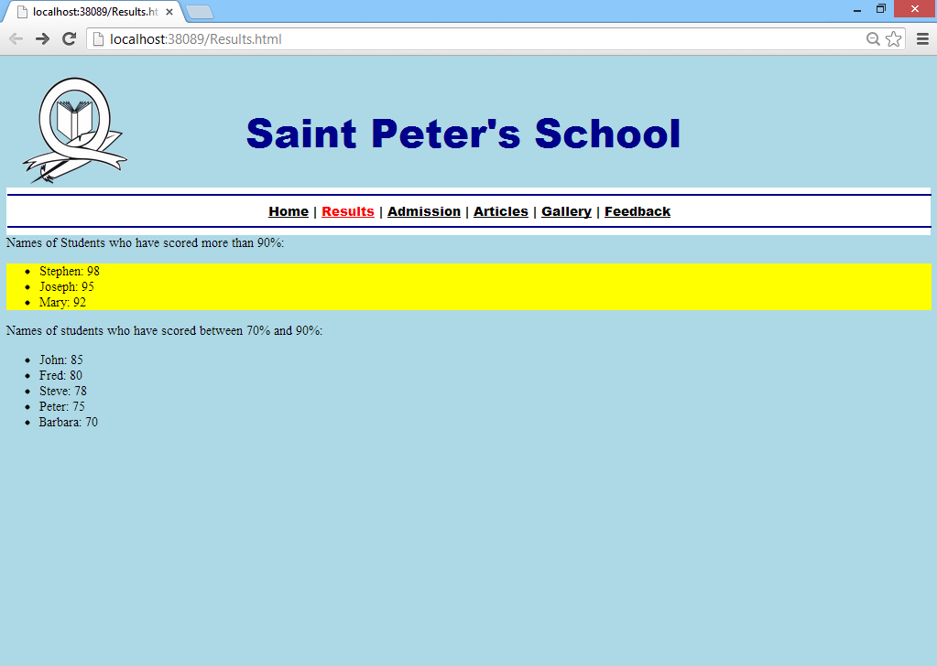
Using Attribute Values (Contd.)
The following figure displays the output of the preceding code snippet.

Slide 16
Using Element Names
In jQuery , HTML elements can also be selected by referring to their name.
Consider the following code snippet to select all the <h1> elements in a document:
$("h1")
In the preceding code snippet, the <h1> elements are referred to by the name, h1.
In jQuery , you can also select and manipulate the HTML form elements, such as:
  select
  input
  textarea
  button

Slide 17
Using Element Names (Contd.)
To select all the elements of a form, write the following code snippet:
$('input')
The preceding code snippet selects all the input elements inside a <form> element in the HTML document.

Slide 18
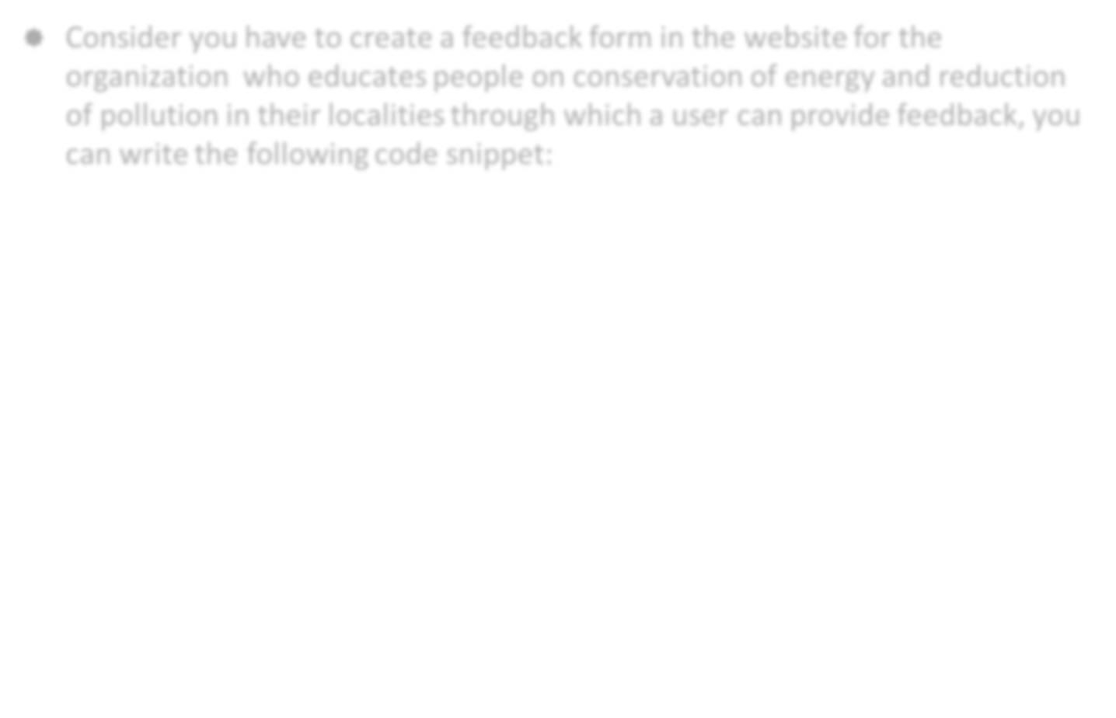
Using Element Names (Contd.)
Consider you have to create a feedback form in the website for the organization who educates people on conservation of energy and reduction of pollution in their localities through which a user can provide feedback, you can write the following code snippet:
<span style="font-size:2em; font-weight: bold">Post your feedback</span>
<form id="form1">
<table style="width:300px;">
<tr>
<td style="width:30%;">First Name</td>
<td style="width:70%;"><input
id="FirstNametextBox" type="text"></td>
</tr>
<td>Last Name</td>
<td><input id="LastNametextBox"
type="text"></td>
</tr>

Slide 19

Using Element Names (Contd.)
<tr>
<td>Feedback</td>
<td><textarea rows="5" cols="60"
id="CommentsTextBox"></textarea></td>
</tr>
<tr>
<td><input id="SubmitButton" type="button"
value="Submit<td>&nbsp;</td>
</tr>
</table>
</form>

Slide 20
Using Element Names (Contd.)
In the preceding code, a feedback form has been created, in which a user needs to provide his/her first name, last name, and feedback.
After this, the user needs to click the Submit button to submit the feedback.
When the user clicks the Submit button, an alert displaying the message, Thanks <username> for your feedback., should be displayed.
To achieve this functionality, you need to write the following code snippet:
$(document).ready(function ()
{
$('#SubmitButton').click(function()
{
var inputs = $('input');
alert("" + "Thanks"+ " " +
$(inputs[0]).val() + " " + "for
your feedback.");
});
});

Slide 21
Using Element Names (Contd.)
In the preceding code snippet, input is used to select all the input elements in the form and these elements are stored in a variable named inputs.
The value of the First Name text box is stored at the 0th index in the inputs variable.
To retrieve this value, you need to write the following code snippet:
$(inputs[0]).val()

Slide 22
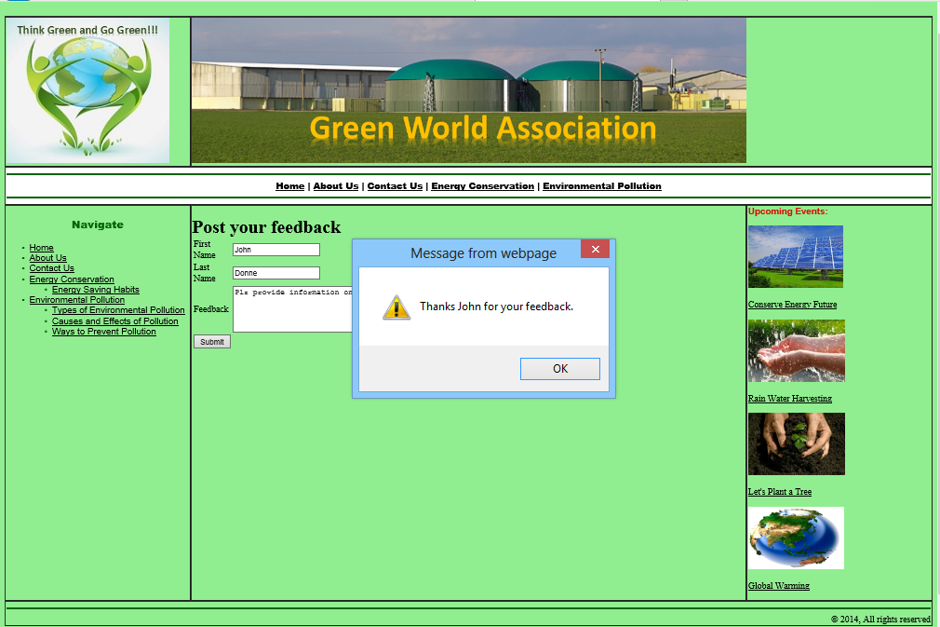
Using Element Names (Contd.)
The following figure displays the output when the user clicks the Submit button after filling the form.

Slide 23
Just a Minute
Which one of the following code snippets will you use to select all the elements of a form?
  $('input')
  $('form')

Slide 24
Just a Minute (Contd.)
Answer:
  $('input')

Slide 25
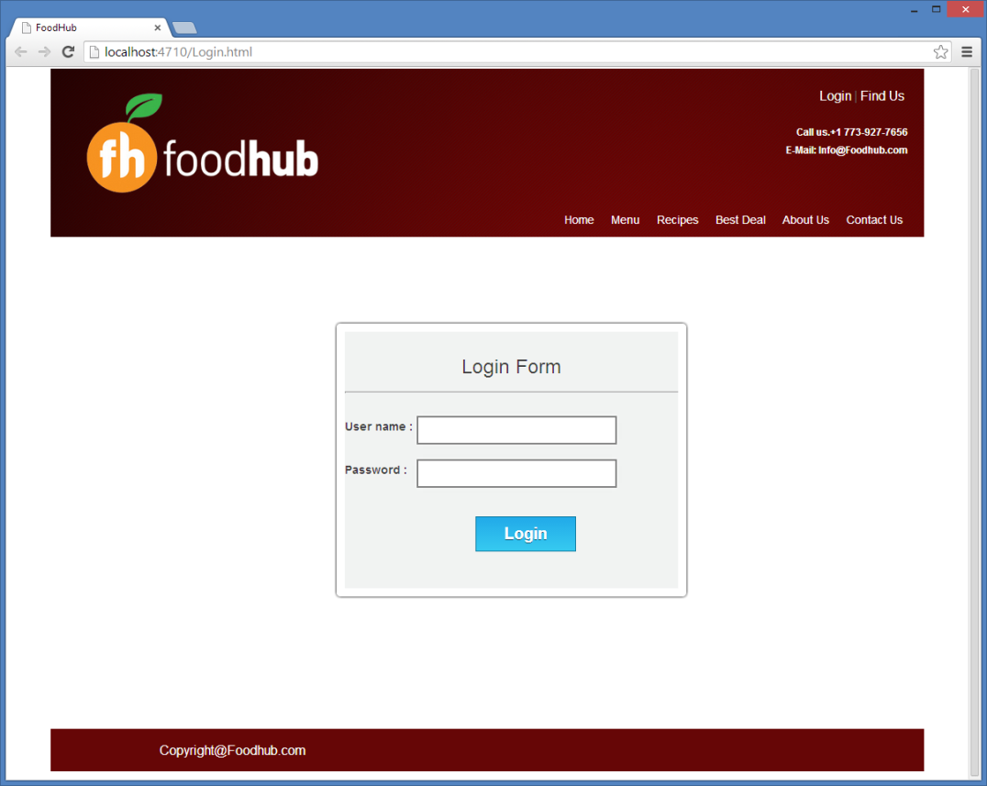
Activity: Performing Client-Side Validation in a Login Form
The management of FoodHub has asked you to create a login form, which will be displayed when a user clicks the Login link on the home page. In addition, you need to implement the following validations in the login form:
  The username and password fields should not be left blank.
  The password should be more than eight characters.
The login form should appear, as shown in the following figure.

Slide 26
Activity: Performing Client-Side Validation in a Login Form (Contd.)
Prerequisite: To perform this activity, you need to use the Foodhub.zip file.

Slide 27
Summary
In this session, you learned that:
  jQuery can be used to manipulate HTML elements and apply complex effects on them.
  You can select the HTML elements by using various jQuery selectors.
  Selectors represent patterns used to select HTML elements that you want to manipulate.
  Some examples of jQuery selectors are:
    :contains()
    :odd
    :even
    :first-child
    :last-child
    :first
    :last
  Apart from the jQuery selectors, you can also select HTML elements using:
    Attribute values
    Element names

Slide 28
What’s Next?
After this session, you need to do the following tasks:
  Read Chapter 6
  Perform Exercise 1 of Chapter 6

